Slide 1
Predicting Diabetes Incidence using Health Indicators
Olusola Akinola|Theresia Sakhi

Slide 2
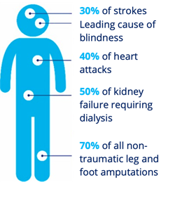
Introduction
Diabetes impacts 30% of Canadians
Occurs when a person cannot produce insulin naturally (Type 1) or the body does not respond to insulin (Type 2)
Increases the risk of other medical conditions such as stroke and heart disease .
Many are undiagnosed
(Canadian Diabetes Association, 2024)
Notes:
Diabetes is among the most prevalent medical conditions impacting Canadians today. Around 30% of canadians live with diabetes or prediabetes. The condition occurs when the body cannot produce insulin naturally, such as in the case of Type 1, or the body becomes insulin resistant and doesn't respond to insulin hormones such as in type 2. Insulin is the hormone responsible for regulating blood glucose levels. The condition is set to contribute to other comorbidities such as heart disease and stroke, and severe cases can lead to kidney failure as well as leg and foot amputation. Many people suffering from type 2 diabetes live undiagnosed and are therefore at risk of these complications if they do not seek treatment.

Slide 3
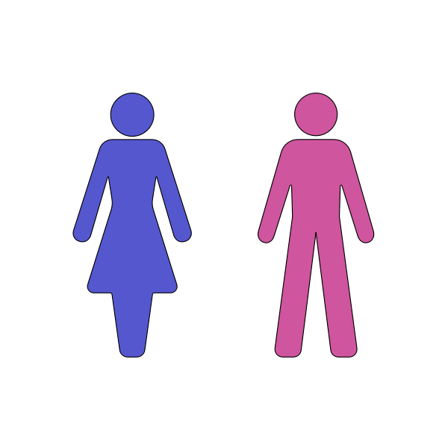
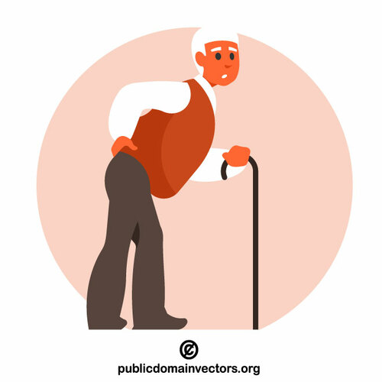
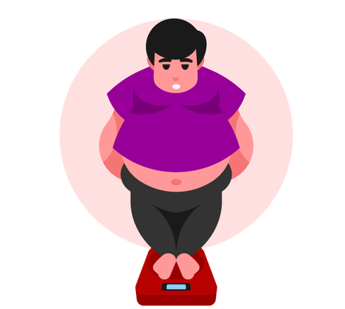
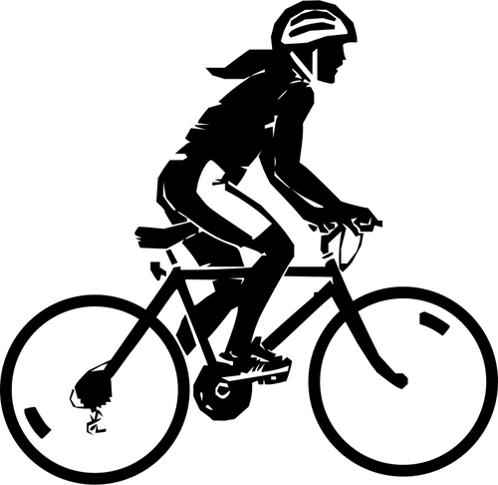
Background
Several risk factors may contribute to Type 2 diabetes
These include:
Gender
Age
Obesity
Lifestyle
Prediabetes - Elevated blood sugar, can progress into Type 2 if left untreated
Notes:
Unlike Type 1 diabetes which typically develops during childhood, type 2 diabetes develops in adulthood due to a number of factors. Some risk factors for type 2 diabetes include gender, as males are more likely to develop the condition than females, age, as the likelihood of developing the condition increases with age, Obesity as high BMI is often associated with the condition and lifestyle factors such as smoking which increases likelihood, and living an active lifestyle which decreases your likelihood. It is important to be vigilant about your health if you possess these risk factors.These factors put you at a risk of developing pre-diabetes, which is characterized by elevated blood sugar levels. If prediabetes is left untreated, it can lead to the development of type 2 diabetes.

Slide 4
Purpose:
Create a machine learning model that can predict diabetes incidence based on health indicators
Notes:
What if we can create a machine learning model that can predict the incidence of diabetes based on these risk factors?

Slide 5

Background cont
Diabetes Health Indicators Dataset
Data taken from the 2015 The Behavioral Risk Factor Surveillance System( BRFSS) survey collected by the CDC
Respondents were asked a series of health-risk related questions as well as their diabetes status
Included in the data set are 21 variables that have been shown to impact diabetes incidence
Incidents of diabetes and prediabetes were combined in the data
Source: https://www.kaggle.com/datasets/alexteboul/diabetes-health-indicators-dataset/data
Notes:
The data that we have chosen to train our model comes from the Behavioral risk factor Surveillance System survey conducted by the cdc.
This survey aims to collect data from American residents on health-related risk behaviors, chronic health conditions, and the use of preventative services. Respondence are asked a series of health related questions as well as about health conditions such as diabetes. Included in this data set are 21 risk factors that have been shown to have an impact on diabetes incidence. Incidences of prediabetes are combined with diabetes in this data set.
The data set we have chosen to use is titled “diabetes health indicators data set and can be found on kaggle.

Slide 6
Key Definitions
Diabetes_binary - No Diabetes, Diabetes/Prediabetes
HighBP - No High Blood Pressure or High Blood Pressure
HighChol - No High Cholesterol or High Cholesterol
CholCheck - Yes/No Cholesterol Check in the last 5 years
BMI - Body Mass Index
Smoker - Yes/No smoked over 100 cigarettes in lifetime
Notes:
The following slides show the variables of interest as well as their definition. Diabetes_binary is the target variable and has 2 classes, no diabetes and diabetes/prediabetes which are combined.
Other variables included are BMI, HIGH BP HIGH CHOL.

Slide 7
Key Definitions
Stroke - Yes/No have had a strokeave had heart d
HeartDiseaseorAttack - Yes/No disease or heart attack
PhysActivity- Yes/No Have engaged in physical activity outside of work in past 30 days
Fruits - Yes/No consume fruit at least once per day
Veggies - Yes/No consume veggies at least once per day
HvyAlcoholConsump - Yes/No Heavy drinker (men more than 14 drinks per week, adult women more than 7 drinks per week)
Notes:
Here are some more definitions,

Slide 8
Key Definitions
AnyHealthcare - Yes/No have health care coverage/ health insurance
GenHlth - Self reported general health on a scale of 1-5, 1 = excellent ,5 = poor
MentHlth - Self reported Mental Health for past 30 days, scale 1-30 days
PhysHlth - Self reported Physical Health for past 30 days, scale 1-30 days
DiffWalk - Yes/No Difficulty walking or climbing stairs?
Sex - Male or Female
Age - 13 age categories; 1 = 18-24, 9 = 60-64, 13 = 80 or older
Notes:
Lastly we have gen health in which participants ranked their general health on a scale of 1-5, and physcal health in which participants noted how many days in the past 30 days was their health no good, and age which is separated into 13 age categories.

Slide 9
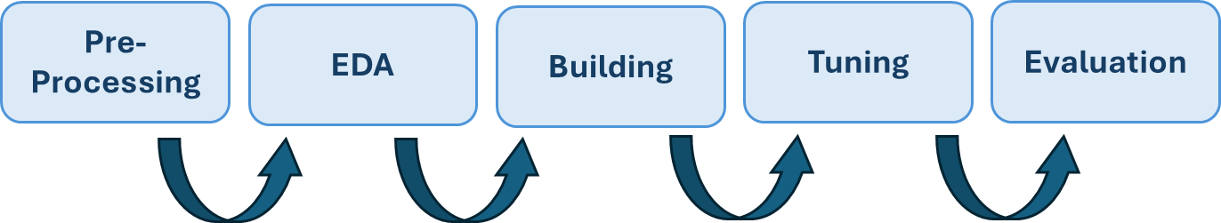
Methodology
Notes:
The data analysis and model building was conducted using Python. We began with preprocessing ….

Slide 10
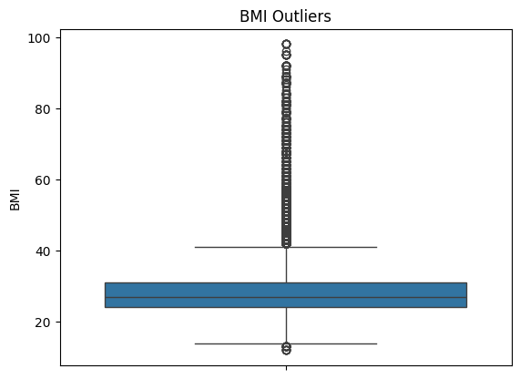
Pre-processing
Removed outliers for BMI
Pro: More representative for general population
Con: High BMI values often associated with diabetes incidence
Notes:
The processing of the data began with removing outliers. Using a boxplot, we were able to visualize the outliers present in the BMI column. While elevated BMI levels are associated with diabetes incidence, we wanted our model to be applicable to a general population so we chose to remove the extreme data points.

Slide 11



Pre-processing
Removed Columns
NoDocbcCost - patients unable to visit doctor due to medical costs
Education - level of education
Income - Income level
Notes:
Additionally, we also removed the columns containing the variables NoDocbcCost, Education, Income. Nodocbccost epresents patience who reported not going to the doctor due to medical costs, while education and income refer to the highest level of education completed and income level.
These factors no doubt play a role in medical care access and contribute to the incidence of diabetes as the condition is more common at lower socioeconomic levels. However, as we are only focusing on self-reported health behaviours and conditions, we have decided to remove these columns from our machine learning model. As well, as this data is take from a survey of U.S. residents, we also feel that financial barriers to accessing medical care likely differ in Canada and the US due to universal healthcare.

Slide 12
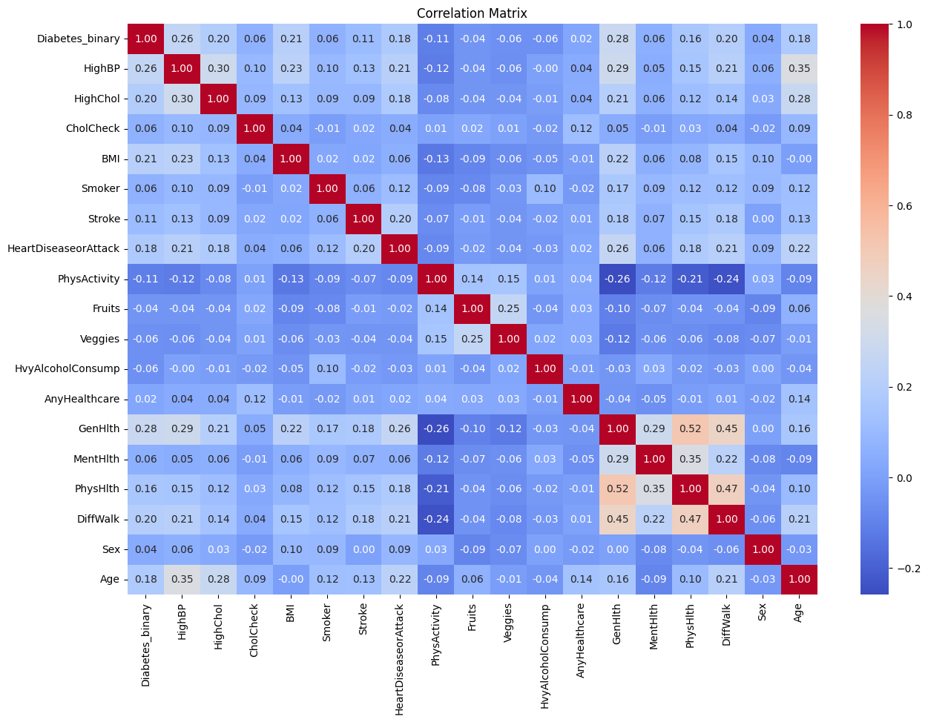
EDA
Created a correlation matrix
Explored relationships between variables
Variables to explore further:
Genhlth, HighBP, BMI, Age
Notes:
After pre-processing we moved on to EDA. We created a correlation matrix to explore the relationship between the variables. The variables we found to have the strongest correlation with diabetes incidence were genhealth and high bp. We decided to explore these relation ships further, as well as BMI and age which also had a higher relative correlation

Slide 13
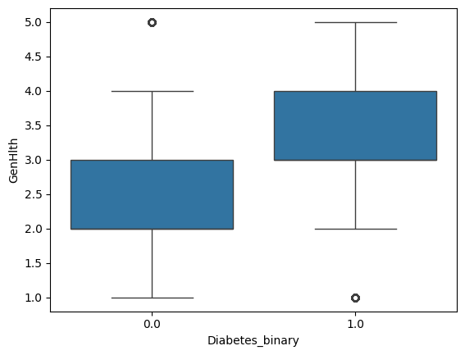
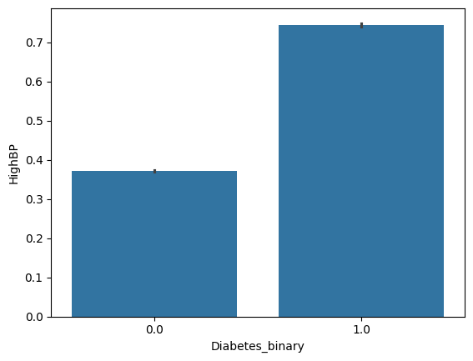
EDA
Notes:
Here we have some plots of Genhlth vs diabetes incidence, and high bp vs diabetes incidence. 0 represence no diabetes, 1 represents diabetes/ prediabetes. As we can see in both grathps poorer reports of general health, as well as incidence of high blood pressure are associated with higher reports of diabetes and pre diabetes.

Slide 14
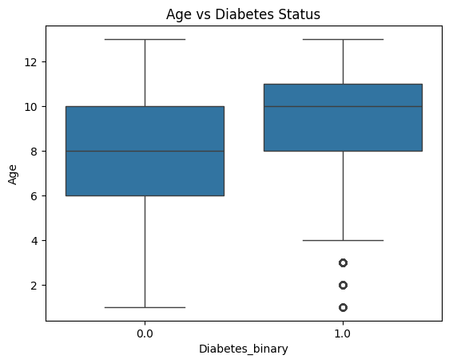
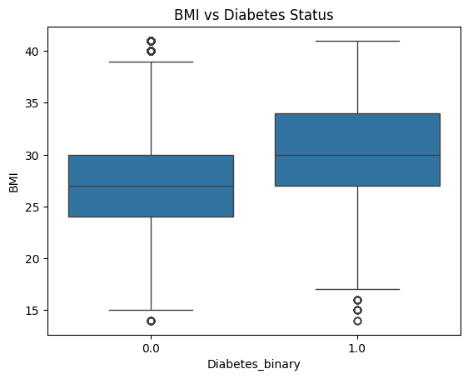
EDA
Notes:
Additionally, higher age was associated with more likely to have diabetes/prediabetes, and higher bmi also had a higher association with incidence of diabetes. Notably, both the average age ( and BMI are

Slide 15
Models
 | Advantages | Disadvantages
Random Forest | High Accuracy Robustness Feature Importance | Overfitting Computationally expensive
Logistic Regression | Efficient and easy to implement Easy to interpret | Assumes linearity Only works for discrete functions
KNN | Simplicity Effective for small datasets | Bad for large datasets Highly sensitive

Slide 16
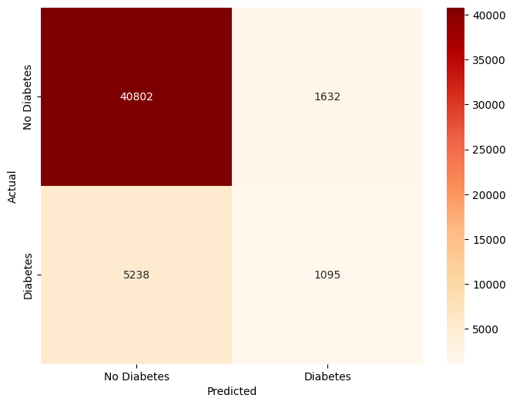
Results
Results
Random Forest
Accuracy Score: 86
True Negatives: 40,802
False Positives: 1,632
False Negatives: 5,238
True Positives: 1,095
Confusion Matrix
Notes:
Based on the 2X2 matrix, we can summarize each score as:
1) True Negatives: 40,802 - The model correctly identified these cases as people who do not have diabetes.
2) False Positives: 1,632 - These cases were incorrectly predicted as having diabetes when they actually didn’t.
3) False Negatives: 5,238 - This number represents people who actually have diabetes but were incorrectly predicted as not having it.
4) True Positives: 1,095 - The model correctly identified these cases as people who have diabetes.

Slide 17
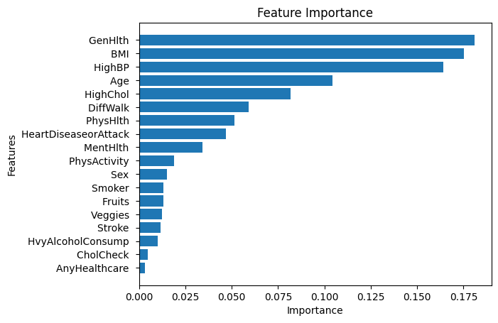
Results
Notes:
One key advantage of random forest is that it can calculate the relative importance of each feature. Feature importance denotes the impact each feature has on the variance of the data. In our data set the most important features, the ones that contribute sthe most to the accuracy of the the model, was identified to be genhealth, BMI, high Bp and age. The same features identified to have the highest correlation with diabetes incidence.

Slide 18
Hyperparameter Tuning
Grid Search
Identifies Hyperparameters that will optimize the performance of the model to improve accuracy.
Parameters calculated for Random Forest:
min_samples_leaf: 4,
min_samples_split: 15,
n_estimators: 20
New accuracy: 87
Notes:
We utilized grid search to identify the combination of hyper parameters that would optimize our model. Ultimately, the accuracy ended up improving by only 1 percent.

Slide 19
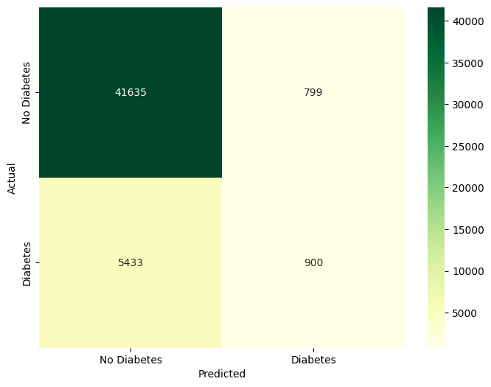
Results
Results
Logistic Regression
Accuracy Score: 86
True Negatives: 41,635
False Positives: 799
False Negatives: 5,433
True Positives: 900
Confusion Matrix

Slide 20
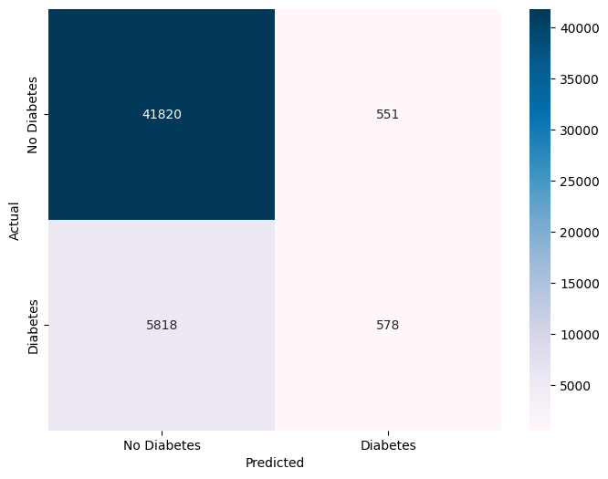
Results
Results
KNN
Accuracy Score: 87
True Negatives: 41,820
False Positives: 551
False Negatives: 5,818
True Positives: 578
Confusion Matrix

Slide 21
Results
Final model: Random Forest
Most efficient at handling large and complex data set
Most True Positives
Less sensitive to noise
Can calculate feature importance
Notes:
The final model we decided to go with was random forest. While the accuracy of each model was relatively equal, random forest works the most efficiently with the large data set and is able to show us the feature importance.
## We proceeded to adopt the Random Forest classifier due to its ability to handle various data types and complexities. Given the size and number of variables in our dataset, Random Forest was chosen for its robustness, as it is less sensitive to noise and outliers.

Slide 22

Application
Healthcare
Healthcare practitioners can utilize the model to help diagnose patients less invasively
Can advise higher risk patients to seek care/make lifestyle changes
Self-diagnosis
Individuals can identify if they are at a higher risk and seek medical help
Notes:
The model can be utilized by healthcare practitioners to aid in diagnosing patients in less invasive ways, and can also identify those with prediabetes/higher risk so they can be directed to the care they need. As the model only requires self-reported health data, any individual can utilize it to see if they are at risk and need to seek medical guidance

Slide 23

Application
Limitations of Model
Relies on self-reported data
Inaccuracy
Social-desirability Bias
Healthcare data could be integrated
Barriers to healthcare not addressed
Notes:
Some limitations in application of the model are that the model relies on self reported data which may not always be accurate. People may under report or over report certain health factors and behaviours leading to inaccuracies.In the future, other healthcare data such as blood test and hormone level tests could be integrated into the model by healthcare professionals in order to improve accuracy.
Additioanlly, answers could be biased if respondents may feel too embarrassed to give honest answers to certain question due to social-desirability bias. This could possibly be addressed if the survey was given anonymously. Additionally the model does not address barriers to health care such as socioeconomic status, and regardless of the model, people at high risk may not seek medical care due to outside factors.

Slide 24

Future Directions
Using the Support Vector Machine (SVM) could improve our results, as it is good at finding complex patterns in data, especially when there are clear separations between classes.
However, SVM can be more costly and take longer to run, especially with large datasets. This is because it requires more computing power and time to train.
Prioritize most important features (Genhlth, HighBP, Age and BMI) to optimize the model performance

Slide 25
Conclusion/Summary
Diabetes is a highly prevalent disease in Canada
Many are undiagnosed which can lead to life threatening complications
Our model uses health indicators in order to predict diabetes incidence
The final MLM is a Random Forest due to its ability handle large and complex data with accuracy
We hope to apply our model to the healthcare sector, allowing healthcare providers and patients to diagnose diabetes more efficiently
In the future we hope to use SVM in order to improve the models accuracy

Slide 26
References
https://www.diabetes.ca/advocacy---policies/advocacy-reports/national-and-provincial-backgrounders/diabetes-in-canada
https://www.hopkinsmedicine.org/health/conditions-and-diseases/diabetes

